Slide 1
Project Title:
Al-Enhanced Career Guidance System for Personalized Career Pathways.
CSE7101- Capstone Project
Review-2
Batch Number: ISE_37
Under the Supervision of,
Mr. JaiKumar
Assistant Professor
School of Computer Science and Engineering
Presidency University,
Bangalore
Roll Number | Student Name
20221ISE0151 20221ISE0132 20221ISE0125 | Shreyas G Gowda Amoolya P N Soujanya Oralagi
Name of the Program: ISE
Name of the HoD: Dr. Zafar Ali Khan N
Name of the Program Project Coordinator: Ms. Suma N G
Name of the School Project Coordinators: Dr. Sampath A K , Dr. Geetha A

Slide 2
Problem Statement Number: PSCS_470
Organization : AI-enhanced Smart Education
Category : Software
“AI-powered career guidance software platform that provides personalized career
pathways using aptitude analysis, skill gap detection, and predictive forecasting.”
Problem Description:
The AI-powered career guidance system is designed to provide personalized career pathways for students and professionals by analysing their aptitude, aspirations, abilities, and work experience. Unlike traditional counselling, it leverages AI-driven assessments and predictive analytics to recommend tailored career options, highlight future progression opportunities, and suggest targeted learning to fill skill gaps. With an intuitive and user-friendly interface, the system ensures that individuals at any stage— whether exploring initial choices or considering a career shift—receive data-driven, future-oriented guidance aligned with their unique profile and long-term goals.

Slide 3
Objectives
Provide AI-powered personalized career guidance..
Assess students aptitude and skills for career mapping .
Identify skill gaps and suggest targeted learning resources.
Deliver holistic education, upskilling and career growth recommendation,
Track student progress and give continuous career guidance updates.

Slide 4
Background and Related work for title Selection
Traditional career counseling methods are generic and lack personalization.
Existing tools rely on static aptitude tests with limited adaptability.
Rapid industry changes create a gap between students skills and job demands.
AI and data analytics enable personalized and predictive career guidance.
Growing demand for adaptive career systems due to rapidly changing job markets.
Helps students make informed decisions and reduce career mismatches.

Slide 5
Analysis of Problem Statement
1. Generic Guidance Systems
Existing career counseling tools provide general suggestions that do not match individual skills, interests, or aspirations.
Students often receive one-size-fits-all recommendations, leading to poor career choices.
2. Mismatch Between Skills and Market Demands
Rapid changes in industries create a gap between student skills and job requirements.
Without proper forecasting, students prepare for careers that may not remain relevant in the future.

Slide 6
Analysis of Problem Statement
3. Limited Personalization
Traditional methods rely on static aptitude tests and fail to use data-driven insights for tailoring career pathways.
This lack of personalization causes career mismatches and underutilization of potential.
4. Fragmented Information Sources
Career-related information is scattered across multiple platforms, making it hard for students to form a clear pathway.
The absence of a unified platform adds to confusion and indecision.
5. Outcome of the Problem
Career choices based on peer pressure or incomplete knowledge lead to dissatisfaction, career switching, and skill gaps.

Slide 7
Analysis of Problem Statement (contd...)
Generic Guidance Systems
→ Existing platforms give one-size-fits-all suggestions without considering individual skills and aspirations.
Mismatch with Job Market
→ Rapidly changing industries create a gap between student skills and future job requirements.
Limited Personalization
→ Static aptitude tests lack data-driven insights, leading to mismatches and underutilized potential.
Accessibility Issues
→ Professional career counseling is often unavailable in remote or under-resourced areas.
Fragmented Information
→ Career resources are scattered across multiple platforms, making it hard to form a clear pathway.
Uninformed Decisions
→ Students rely on peer pressure or incomplete knowledge, resulting in dissatisfaction and frequent career switching.

Slide 8
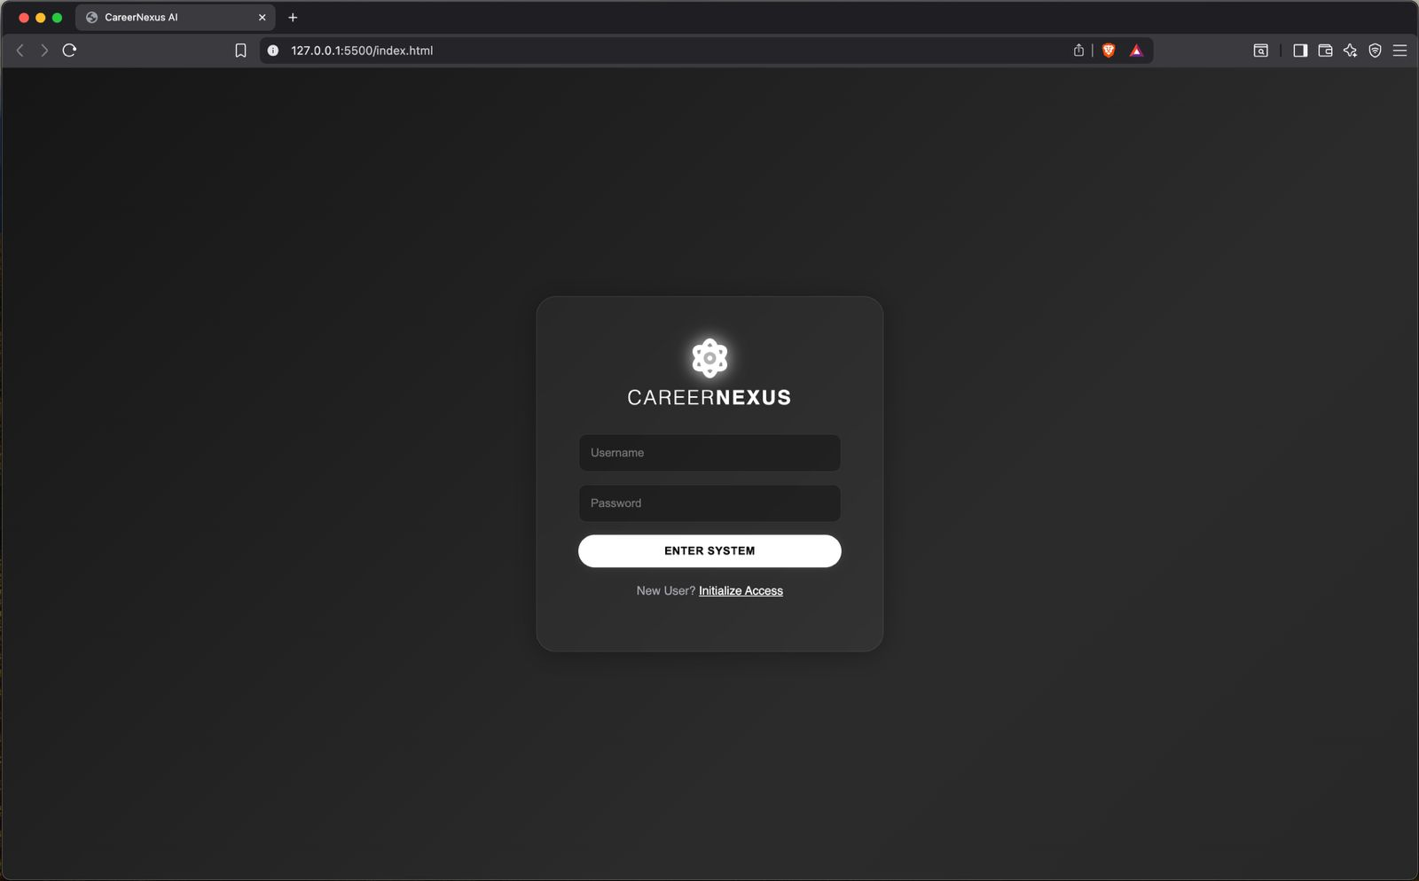
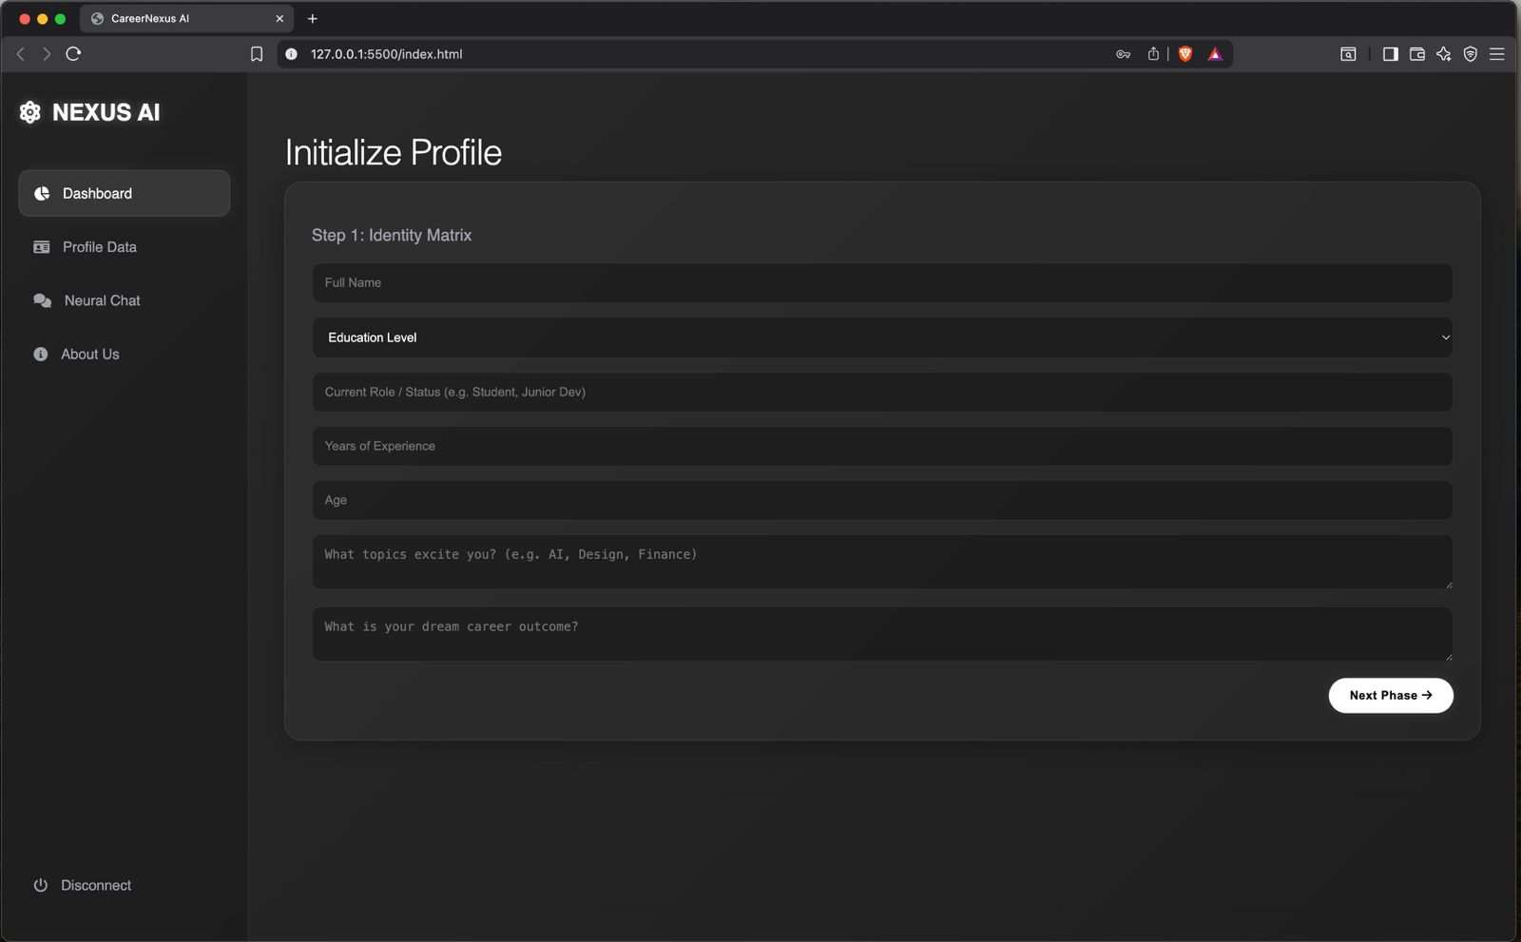
Output:

Slide 9
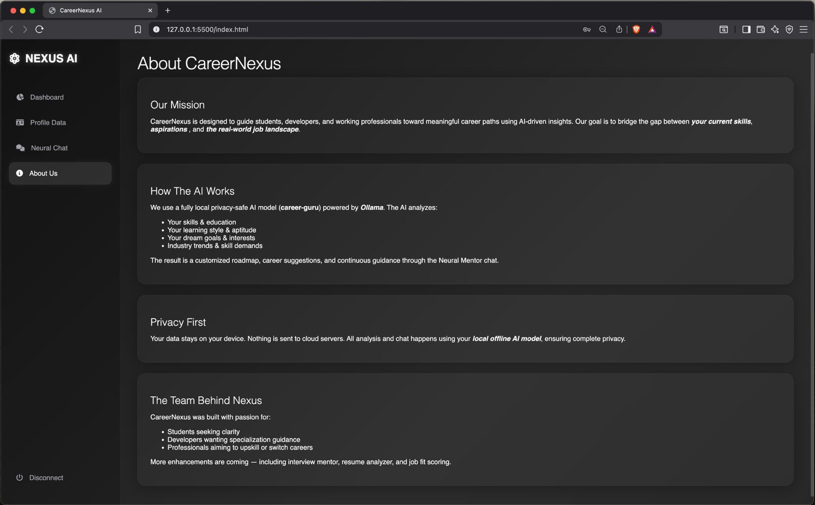
Outputs:

Slide 10
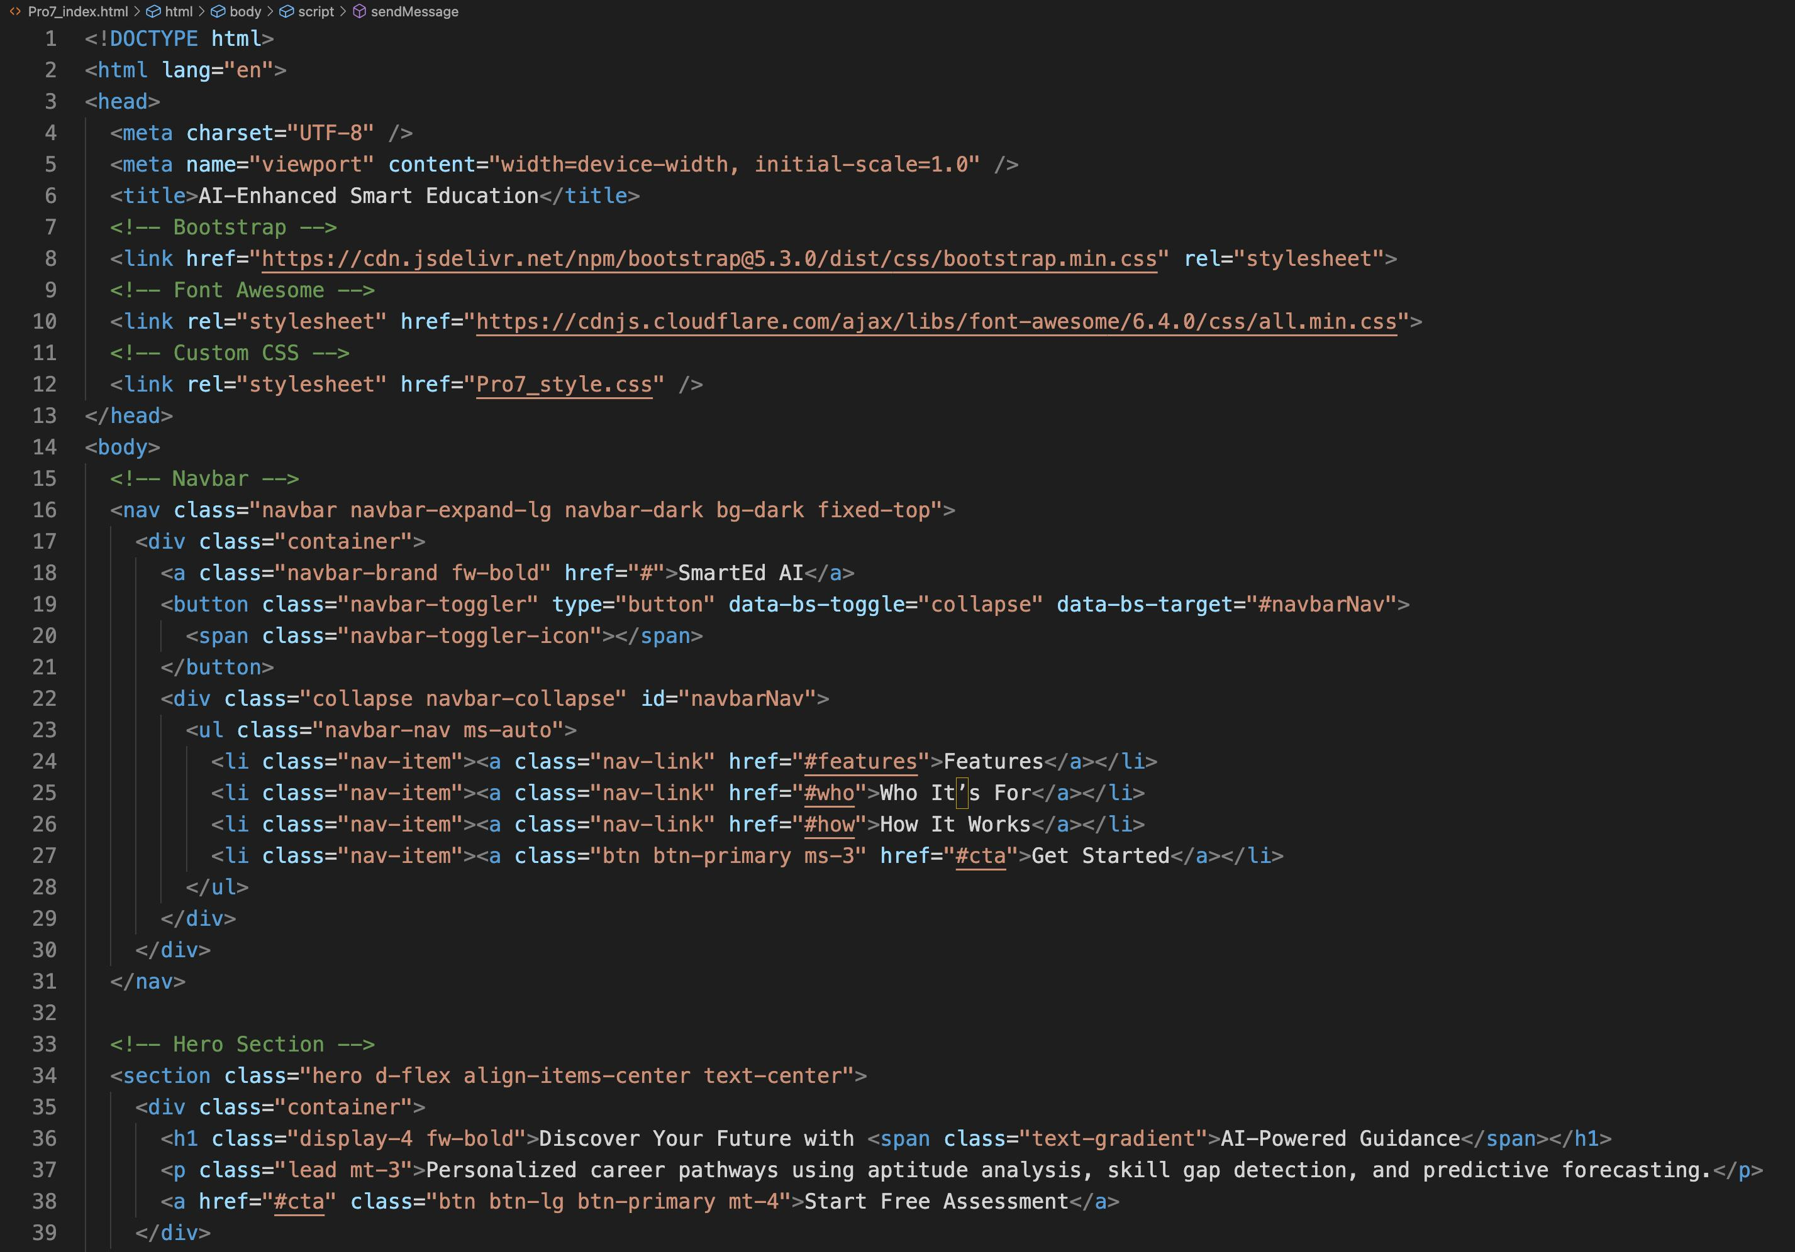
HTML – sample code:

Slide 11
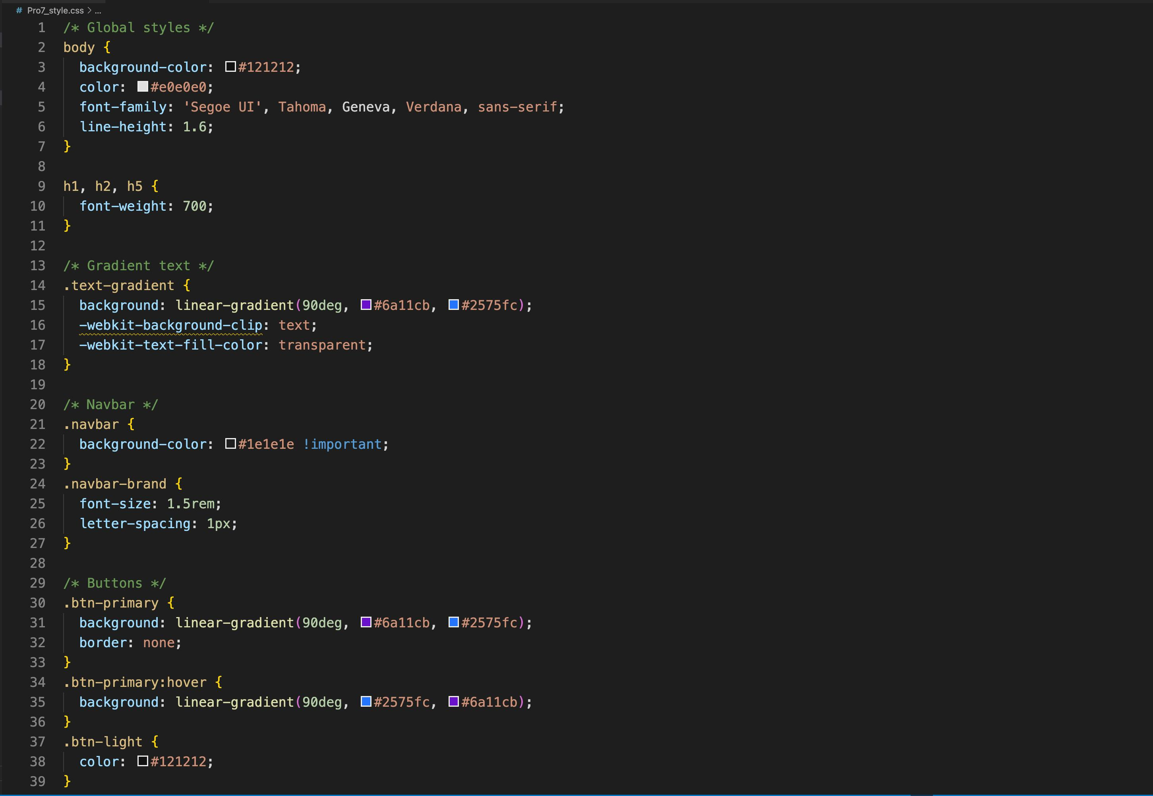
CSS – sample code:

Slide 12
Github Link
Github Link:
shreyasggowda/career_nexus

Slide 13
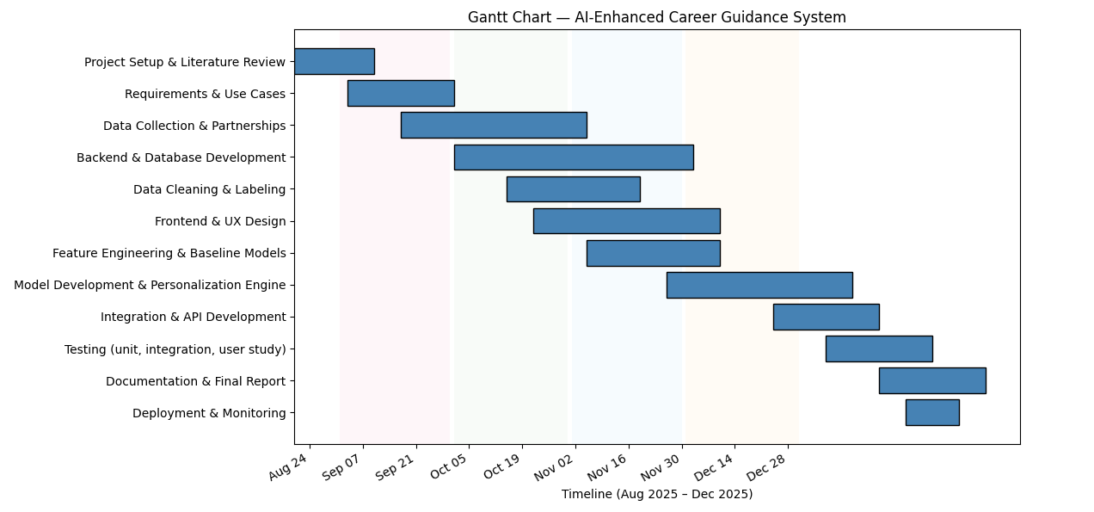
Timeline of the Project (Gantt Chart)

Slide 14
References (IEEE Papers)
[1] Y. Huang, “Individualized career planning intelligent teaching system for college students based on adaptive artificial intelligence,” Journal of Intelligent & Fuzzy Systems, vol. 48, no. 2, pp. 1787–1797, 2025.
[2] V. Vignesh, N. Praveen, and R. Rajesh, “An Intelligent Career Guidance System using Machine Learning,” in Proc. Int. Conf. on Computing and Communication Technologies (ICCCT), 2021, pp. 1–6.
[3] J. Jaspin and A. S. Kannan, “AI Assisted Career Guidance and Resume Screening System,” in Proc. 2024 Int. Conf. on Smart Systems and Inventive Technology (ICSSIT), 2024, pp. 1462–1469.

Slide 15


